Slide 1

Creating Space for New Species
James Brown

Slide 2
When access to nutrition changes
Nutrition

Slide 3
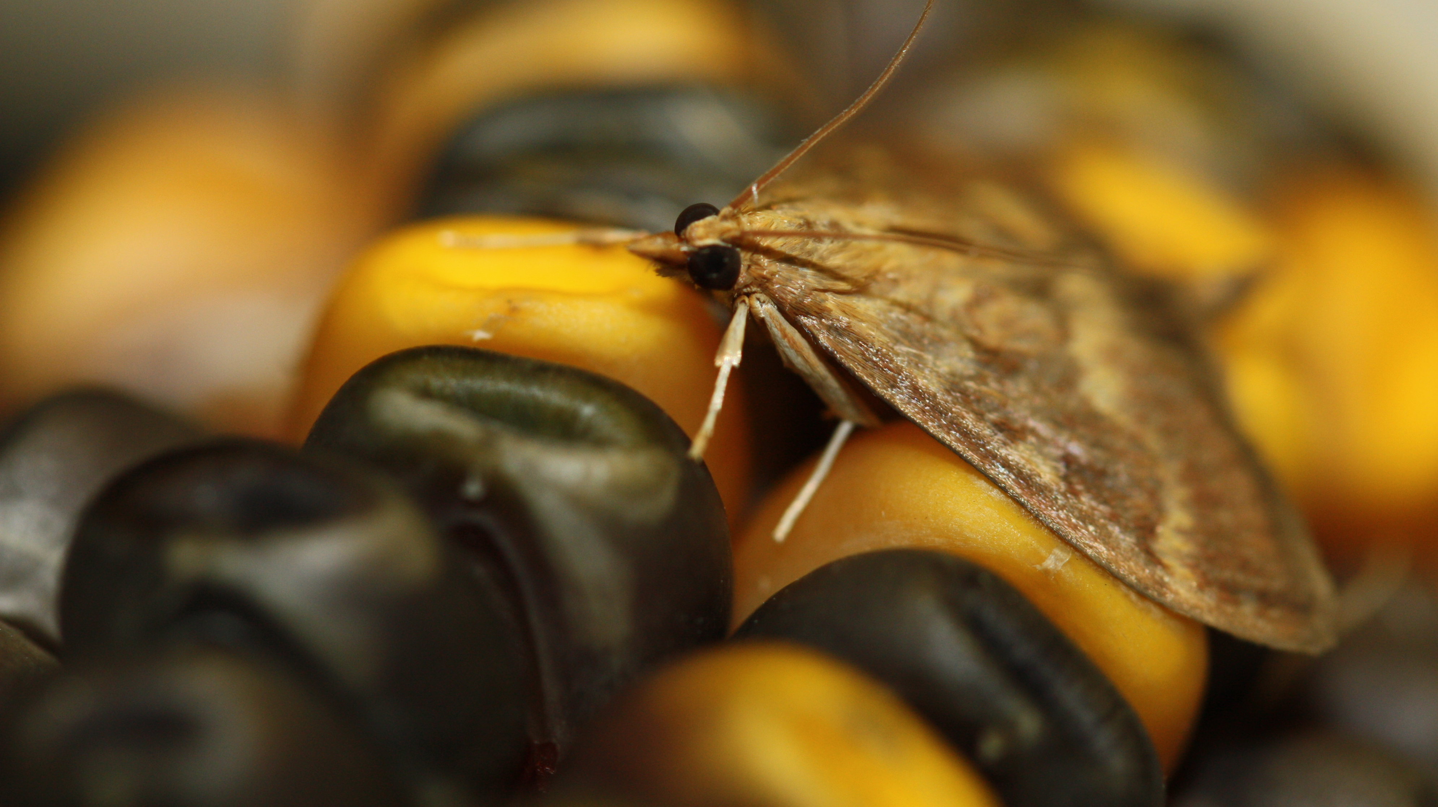

Slide 4
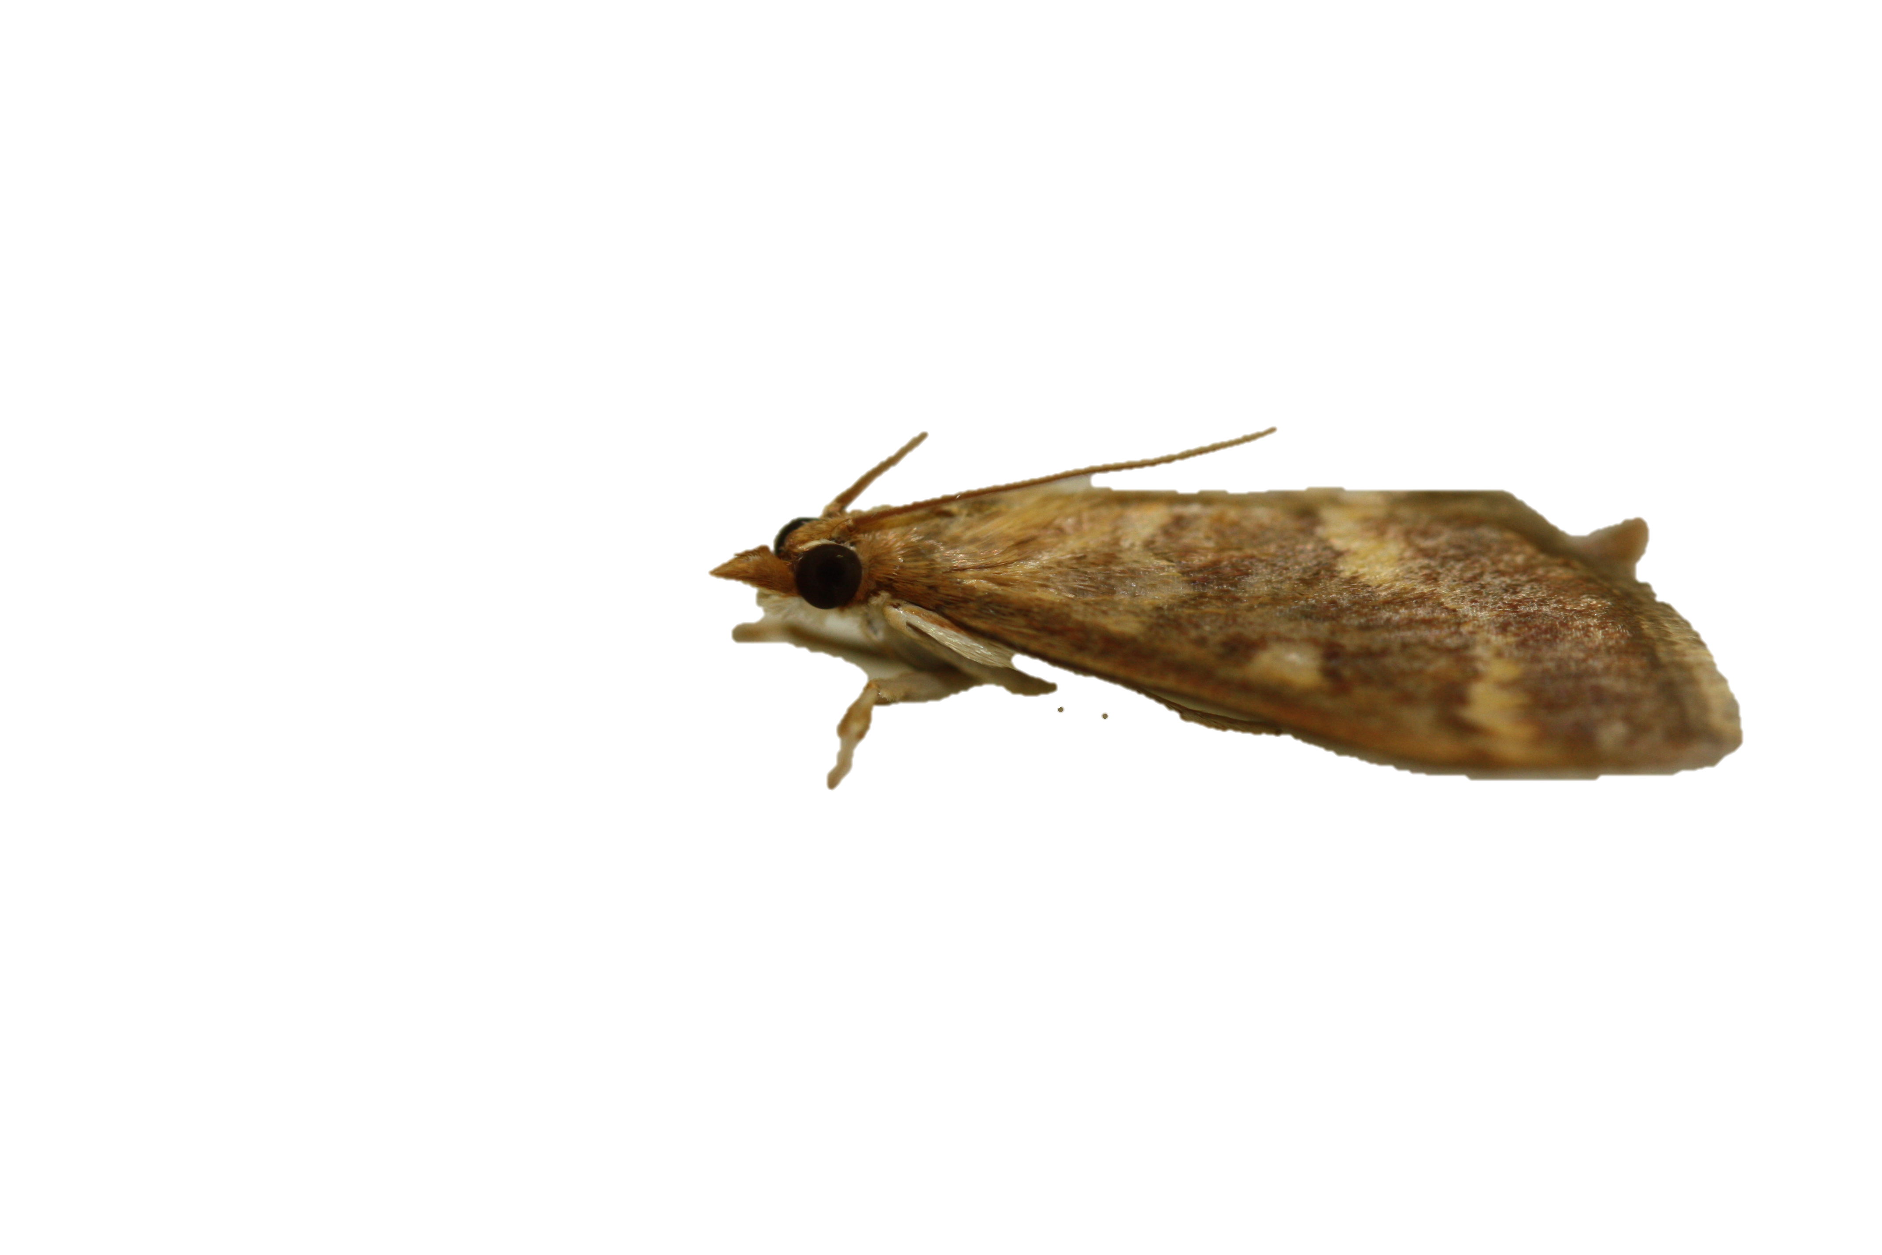
Before Agricultural Corn in Europe
Mugwort was the primary host available
High mate and enemy exposure

Slide 5
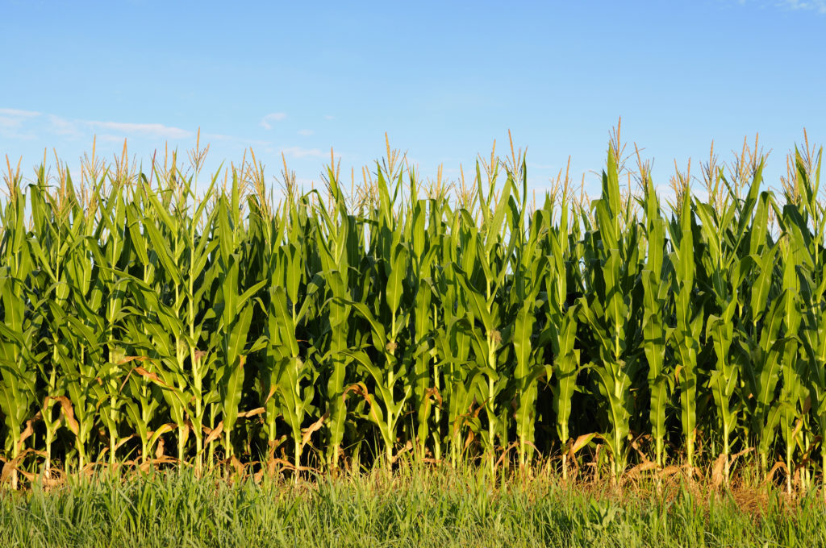
After Corn was Planted
Relatively enemy free host
Abundant
Highly nutritious
http://corncorps.com/2016/01/14/5-things-about-this-photo-an-illinois-landscape/cornfield-background/

Slide 6
When populations are separated in space
Habitat

Slide 8
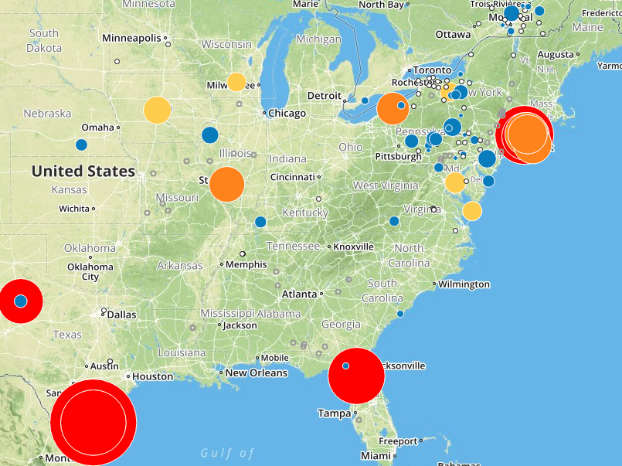
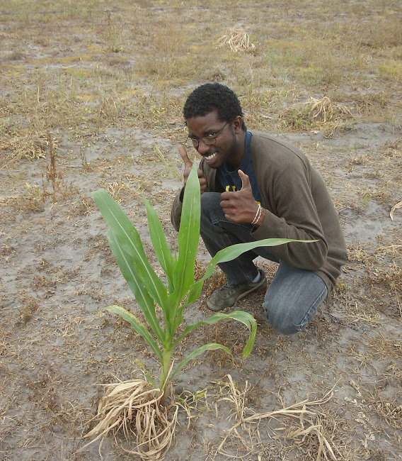
Tracking Migration

Slide 9
Population Migrations
Population reservoirs

Slide 10
When humans create species
Humans

Slide 11
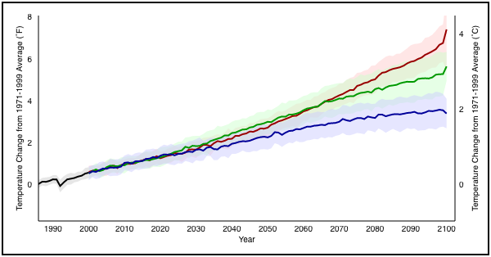


Climate Change: Global Temperature Projections
Increase between 1.1°C and 5°C
Notes:
Warmer temperatures are predicted through the year 2100

Slide 12
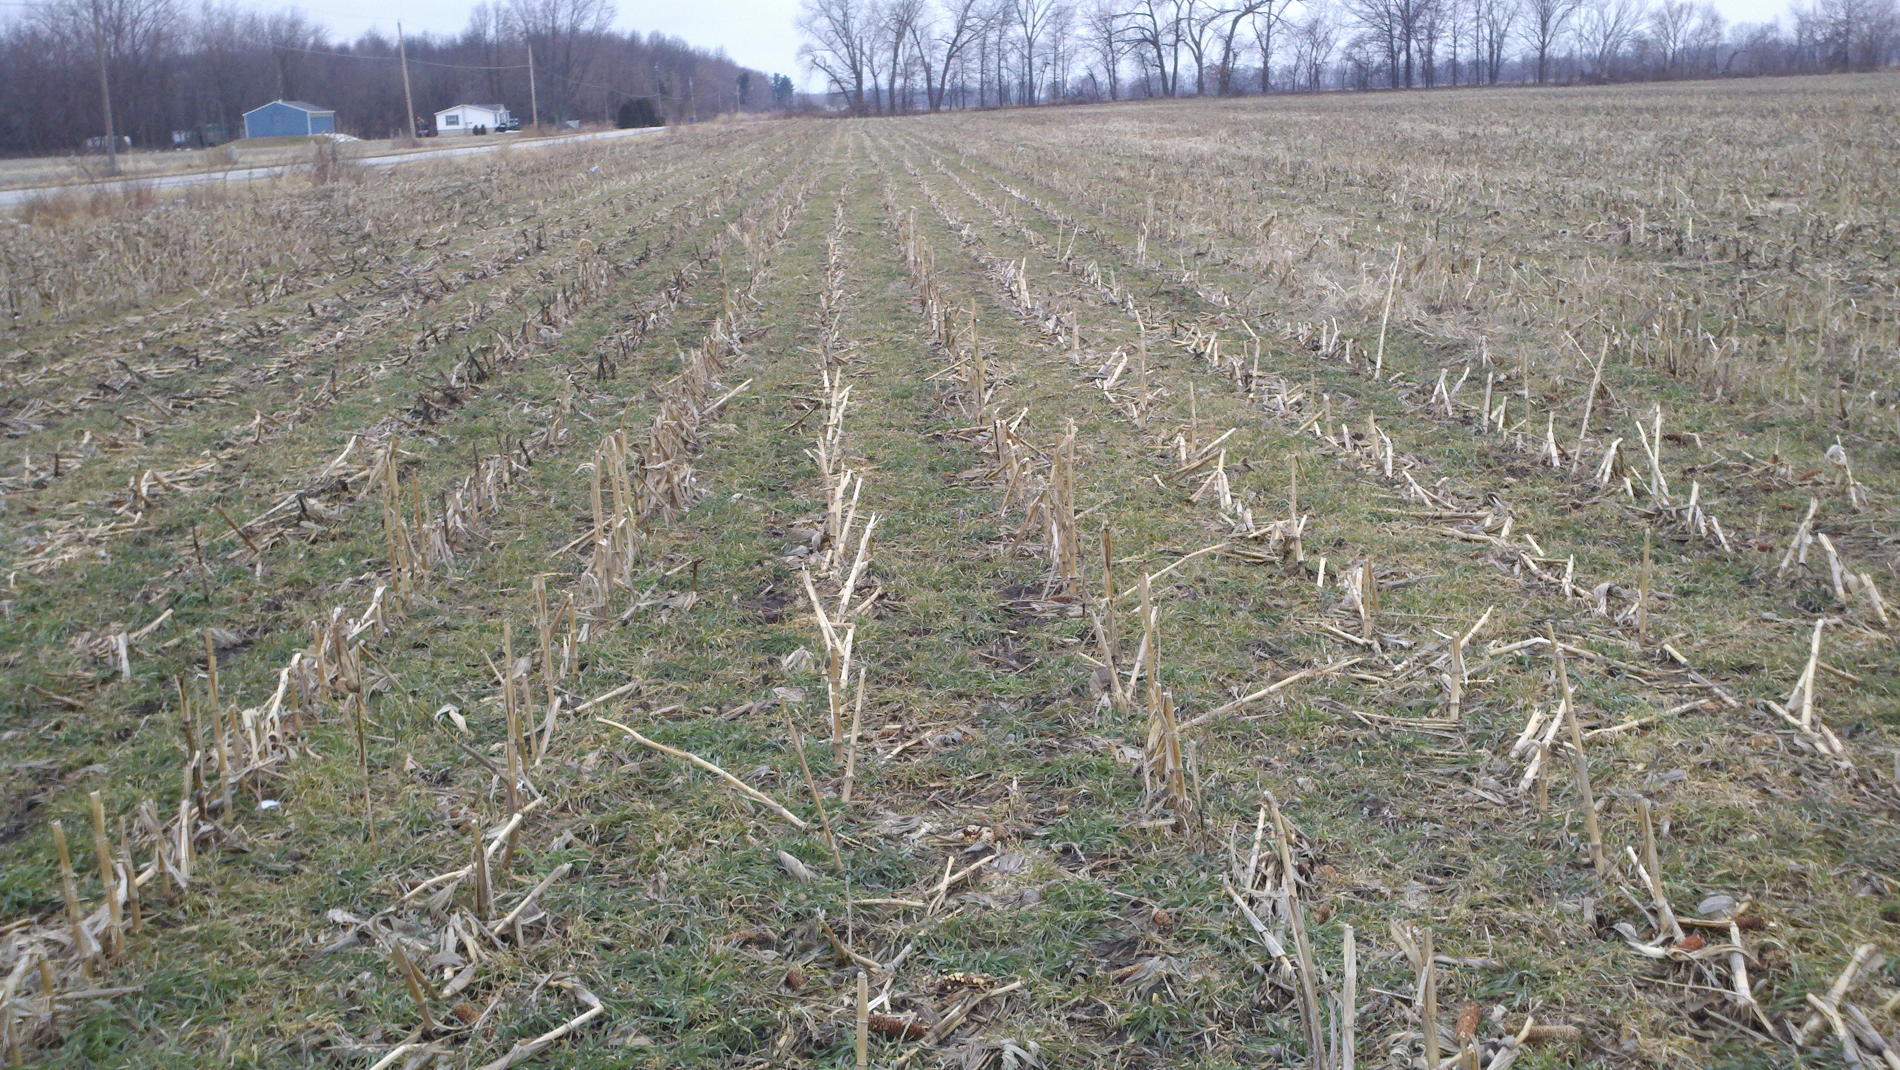
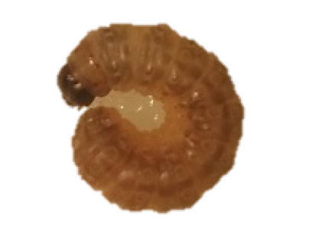

Life History
http://corncorps.com/2016/01/14/5-things-about-this-photo-an-illinois-landscape/cornfield-background/
JAN | FEB | MAR | APR | MAY | JUN | JUL | AUG | SEP | OCT | NOV | DEC
One generation = Limited Damage
Notes:
Start of growing season → Larvae exit diapause, develop into pupa, then adults
During growing season → Eggs hatch, larvae eat, and grow
End of growing season → Ultimate instar larvae enter diapause

Slide 13
Longer Growing Season
http://corncorps.com/2016/01/14/5-things-about-this-photo-an-illinois-landscape/cornfield-background/
JAN | FEB | MAR | APR | MAY | JUN | JUL | AUG | SEP | OCT | NOV | DEC
More generations = More money
$$$$$$$$$$$$$$

